Slide 1
GPUs at a glance
Much higher FLOPS (floating points operations per second) per dollar than CPUs.
Different architecture from a CPU.
Many low throughput processing units
Cores share global memory
Warps/Wavefronts – groups of cores run same code.
Must use a language compiled for GPU
OpenCL – Open programming language for multiple CPUs (on same node) and GPU.
CUDA – Nvidia only.
This Project: OpenCL

Slide 2
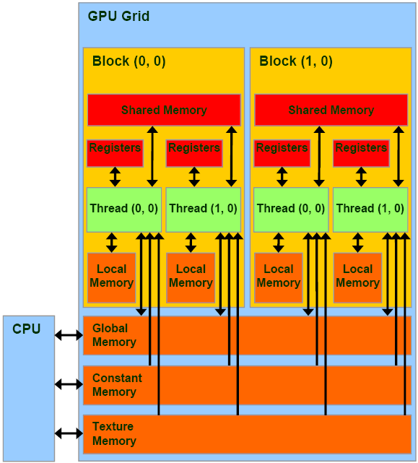
GPU architecture
http://www.realworldtech.com/gt200/3/

